Slide 1


INTERNSHIP PRESENTATION
-- Ingénierie des Systèmes d’information et Réseaux --
Prepared by: ATIGUI Aymane
Jury members BAKKAS Jamal BAYAR Abdelouahad
Supervised by: HACHMI El Ayachi
2022/2023

Slide 2
01
Introduction
Notes:
Hello everyone!
Today, I am excited to share with you my internship experience at SOTRAGEP
Over the last 8-week I had the opportunity to apply my skills and knowledge from Ecole Supérieure De Technologie de SAFI to real-world
In this presentation, I will take you through my journey of bridging the gap between theory and practice.
Let's dive in! By starting with the PLAN

Slide 3
PLAN
1
Introduction
2
The Internship
3
Project Overview
4
Data Modeling and Design
5
Technologies Used
6
Interface Presentation
7
Conclusion
Notes:
Firstly
Next Furthermore Lastly

Slide 4
02
THE INTERNSHIP
Notes:
During my internship at SOTRAGEP, a well-established company in the painting, decoration, and renovation industry. I had the opportunity to contribute to various aspects of the business. This included web development, database management, quality assurance, digital marketing support, and technical troubleshooting. This internship provided me with practical skills and helped me bridge the gap between theory and practice, making a meaningful contribution to the company's collective knowledge.

Slide 5

THE INTERNSHIP
SOTRAGEP
Painting
Decoration
Renovation industry
Notes:
During my internship at SOTRAGEP, a well-established company in the painting, decoration, and renovation industry. I had the opportunity to contribute to various aspects of the business. This included web development, database management, quality assurance, digital marketing support, and technical troubleshooting. This internship provided me with practical skills and helped me bridge the gap between theory and practice, making a meaningful contribution to the company's collective knowledge.

Slide 6

03
Project Overview
Notes:
During my internship
the CEO of the company presented me with a project to work on called JOBIFY.
a platform designed to help job seekers find employment easily.

Slide 7
04
Data Modeling and Design

Slide 8
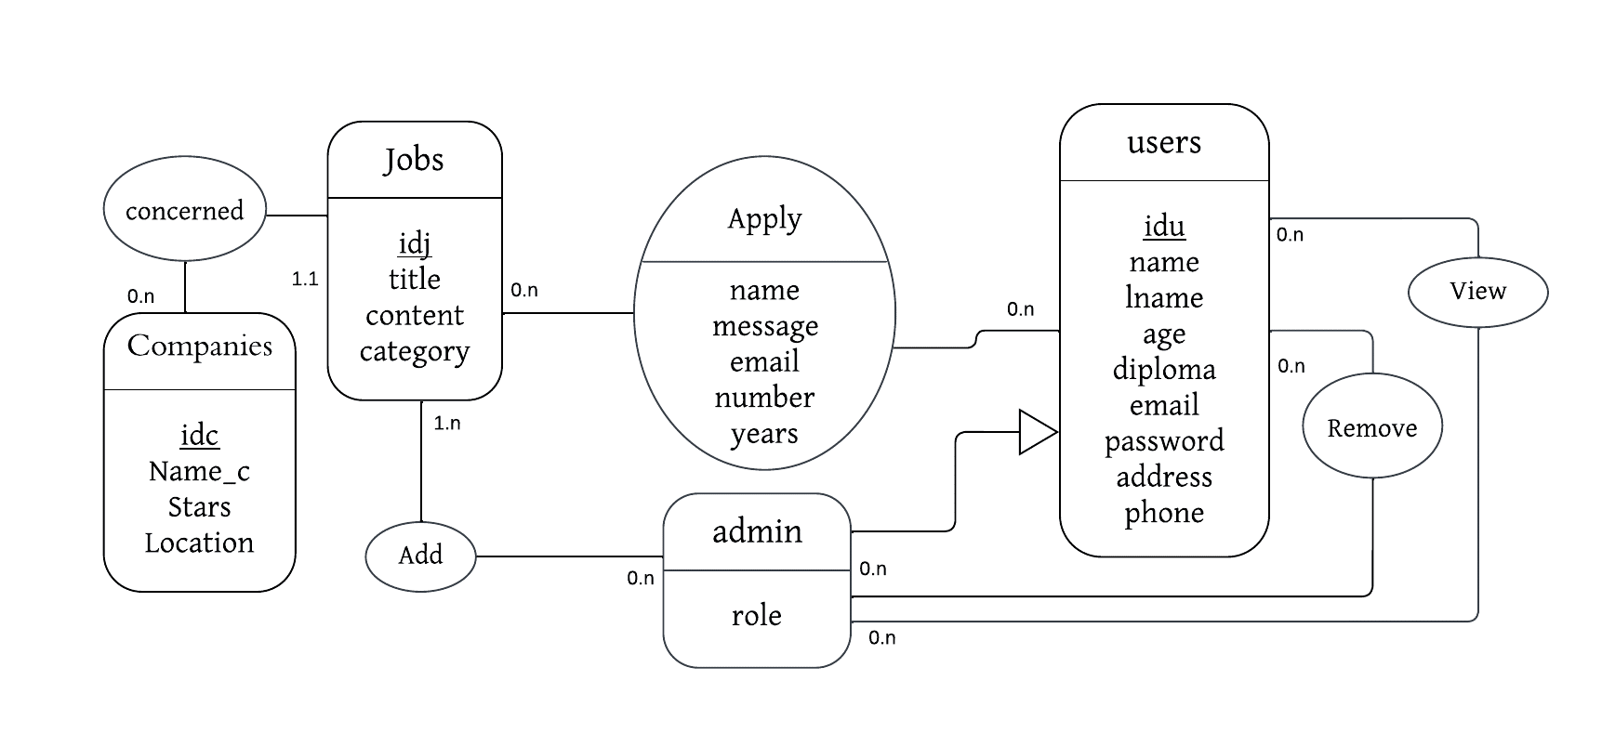
Data Modeling and Design

Slide 9
05
Technologies Used

Slide 10






Technologies Used
Front-end
Back-end
Database
HTML
CSS
Tailwind CSS
React
NODE JS
MONGO DB

Slide 11
06
Interface Presentation

Slide 12
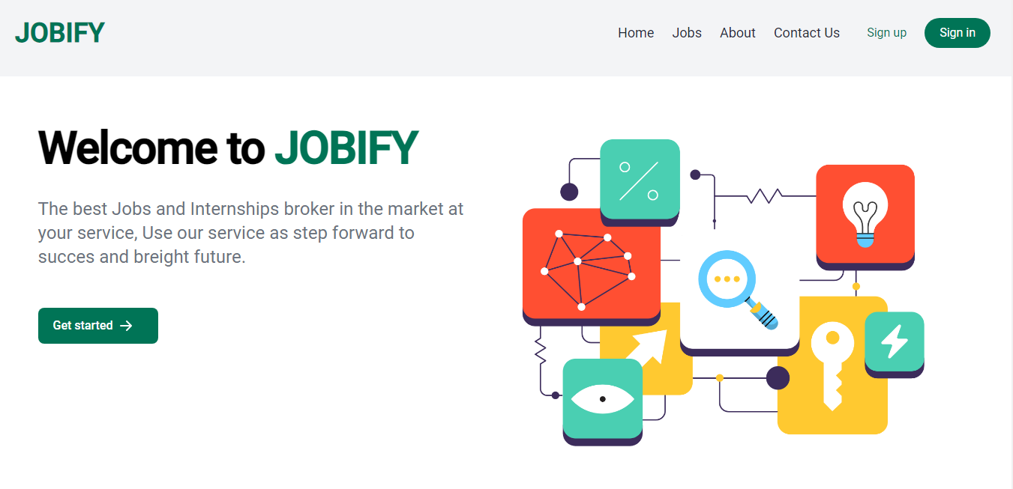
Home Page

Slide 13
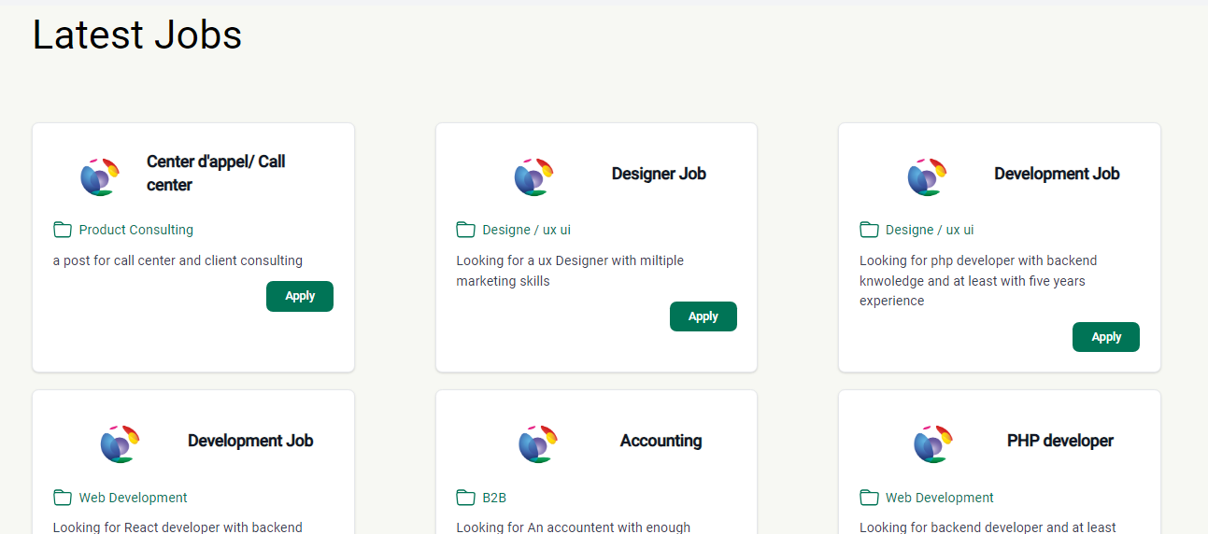
Home Page

Slide 14
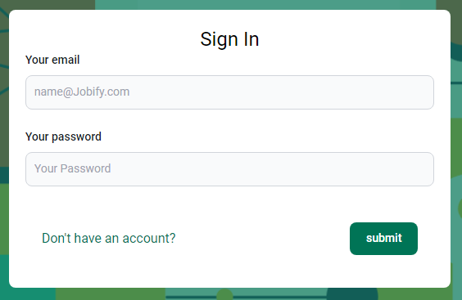
Login Page

Slide 15
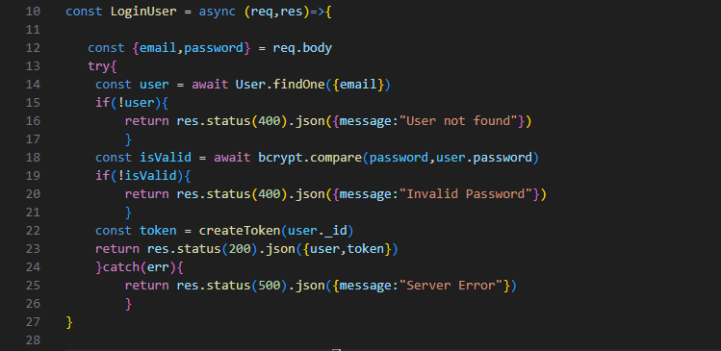
Login Page

Slide 16
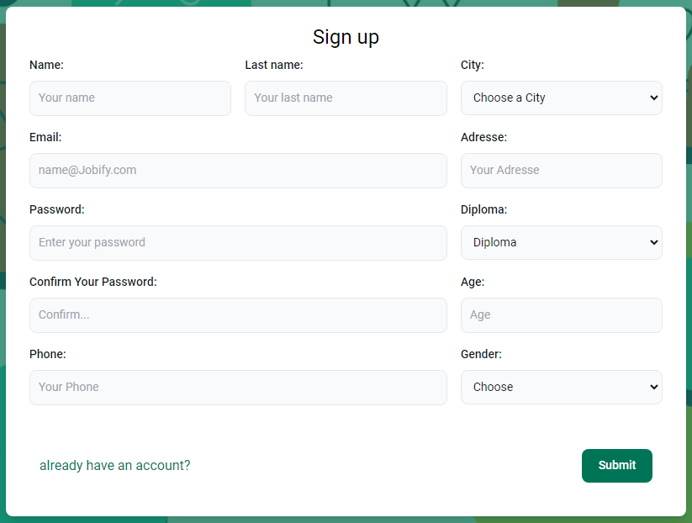
Sign up Page

Slide 17
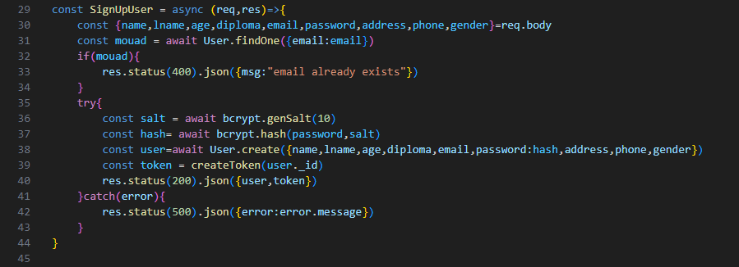
Sign up Page

Slide 18
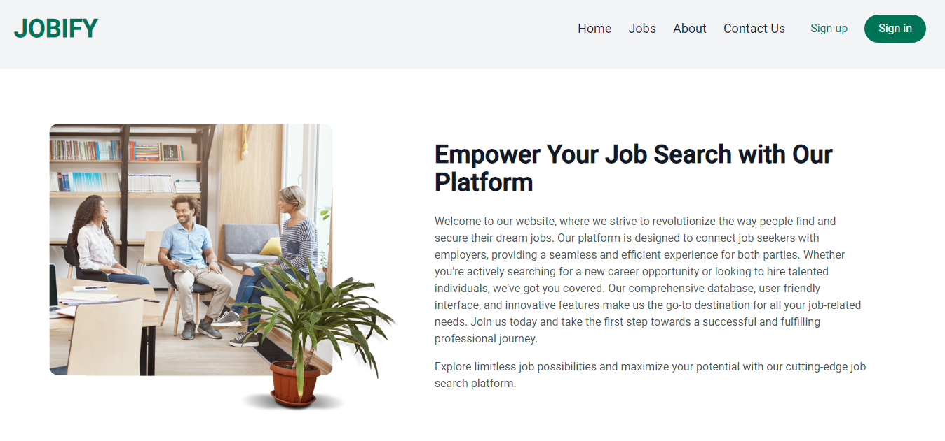
About Page

Slide 19
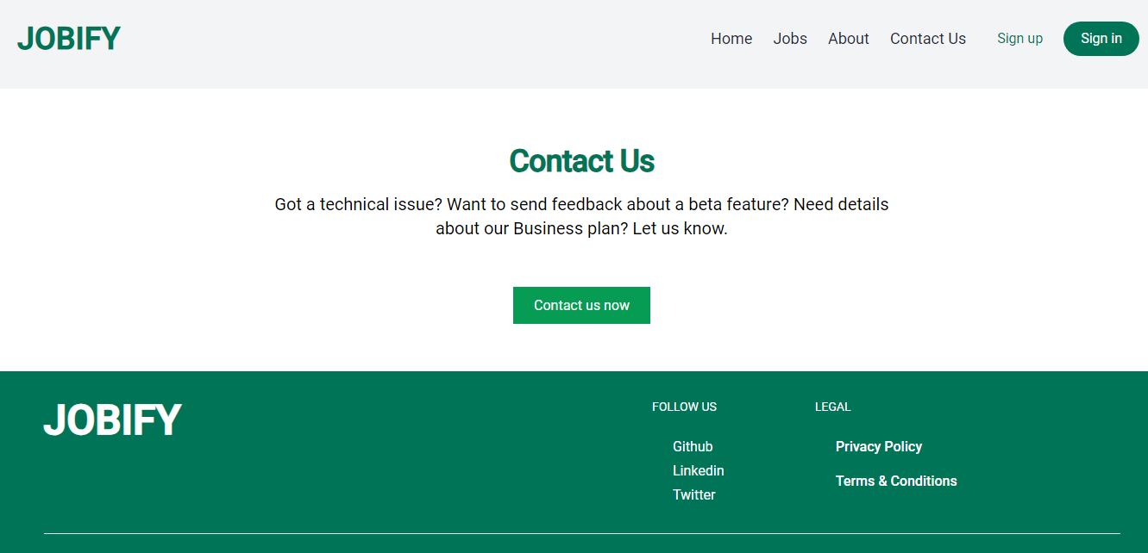
Contact Page

Slide 20
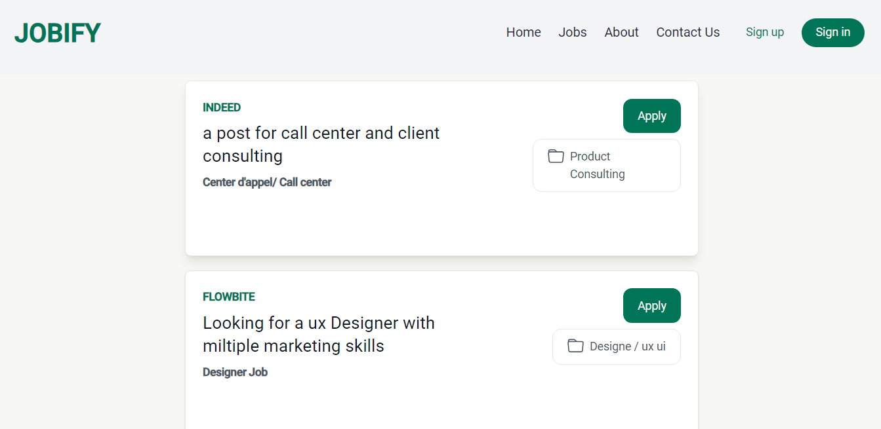
Jobs Page

Slide 21
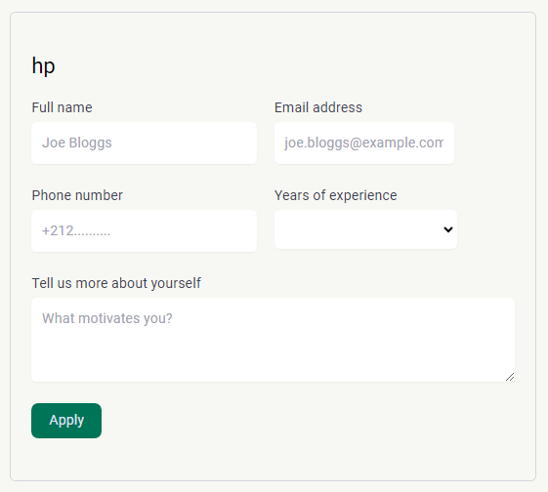
Apply Page

Slide 22
Administrators navbar
For administrators, accessing the Dashboard is made simple through this dedicated link in the navigation bar.

Slide 23
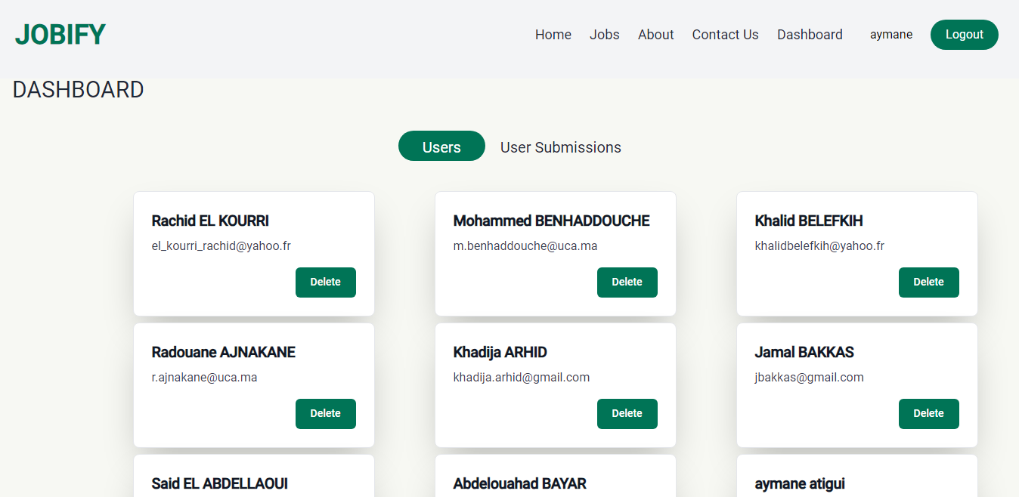
Dashboard Page

Slide 24
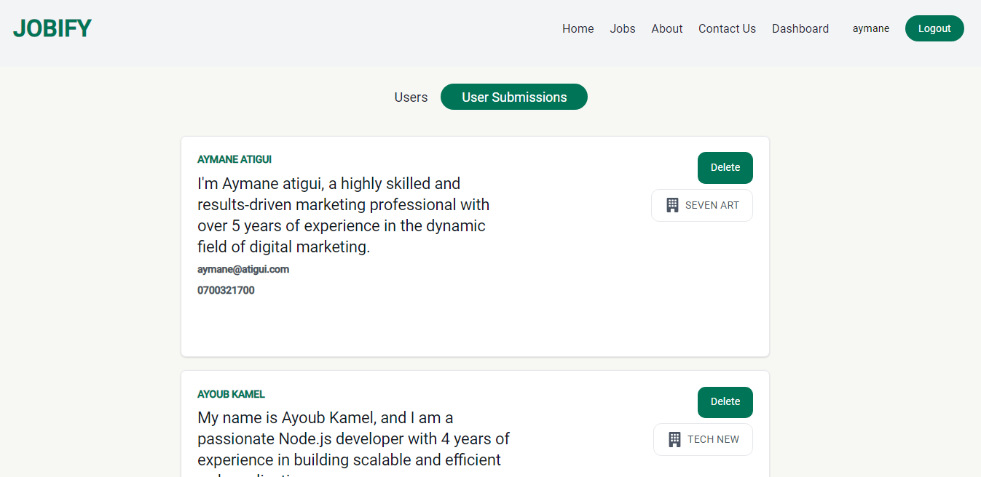
Dashboard Page

Slide 25
07
CONCLUSION
Notes:
As a conclusion, the platform have a big opportunity to scale and a lots to futters to add,
I want also to thanks you, our professors to all things you give us in this year. And I want also thanks ceo of sotragep and muber of the company thanks you

